Slide 1
ETIPs and the SET-Plan
THE EU FRAMEWORK PROGRAMME
FOR RESEARCH AND INNOVATION
Agustin ESCARDINO MALVA European Commission, DG Research and Innovation Deputy Head of Unit G.3, Renewable Energy Sources

Slide 2

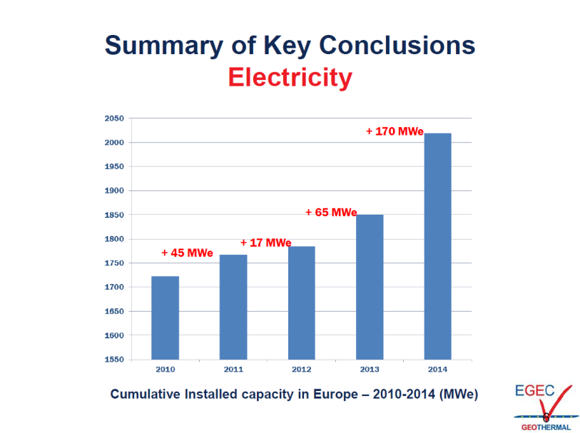

Positive developments & growth in the geothermal sector
EC support to Geothermal Energy R&I
FP6 + FP7: ~49 M€;
H2020:
2014-15 Work Programme: ~70 M€
Geothermal Projects funded (M€)
2014 | 24,1
2015 | 45,6
Total | 69,6
Notes:
H2020 is a core part of Europe 2020, Innovation Union & European Research Area

Slide 3
R&I in Renewables: Work Programme 2014-2015
Outcome by Sector (M€)
Notes:
H2020 is a core part of Europe 2020, Innovation Union & European Research Area

Slide 4

Feb 2015: Energy Union
Energy Union: 5 Pillars
1. Energy security, solidarity and trust
2. A fully integrated European energy market
3. Energy efficiency contributing to moderation of demand
4. Decarbonising the economy
5. Research, Innovation and Competitiveness
⇒ the Strategic Energy Technology Plan (SET Plan) as a key implementing pillar

Slide 5

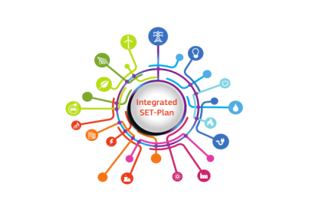

Sept 2015: a new impetus given to the SET Plan
A key innovation pillar of Energy Union
To accelerate the European energy system transformation
A more targeted focus
A more integrated approach
Towards prioritisation
A new SET Plan management:
results-oriented
wider range of stakeholders involved
increased transparency, accountability, monitoring of progress and knowledge sharing
(via SETIS Strategic Energy Technology Information System).
https://setis.ec.europa.eu/

Slide 6
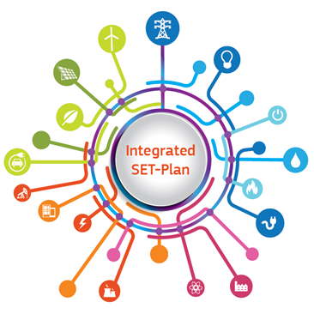
More focused & integrated priorities
Energy Union Priorities
SET Plan Ten Key Actions
4 Core priorities
No1 in Renewables
1. Performant renewable technologies integrated in the system
2. Reduce costs of technologies
Smart EU energy system, with consumer at the centre
3. New technologies & services for consumers
4. Resilience & security of energy system
Efficient energy systems
5. New materials & technologies for buildings
6. Energy efficiency for industry
Sustainable transport
7. Competitive in global battery sector (e-mobility)
8. Renewable fuels

Slide 7
ET-Plan 2/2
More focused & integrated priorities
Energy Union Priorities
SET Plan Ten Key Actions
2 Priorities for interested Member States
9 Driving ambition in
carbon capture storage and use deployment
10 Increase safety in
the use of nuclear energy

Slide 8

The SET Plan Actors
European Commission & Countries
[EU28 + CH, IS, NO, TR]
Steering Group / Bureau
Joint Actions Working Group
Stakeholder platforms
European Technology and Innovation Platforms (ETIPs)
The European Energy Research Alliance (EERA)
Others e.g. European Public-Private partnerships Fuel Cells & Hydrogen, Bio-based Industry, Energy Efficient Buildings, Sustainable process Industry)

Slide 9

SET Plan Prioritisation
For each of the 10 Key Actions
A few R&I targets proposed by the EC from the Integrated Roadmap
Large consultation (Stakeholders/Member States)
Agreement on a limited set of targets ('Declarations of Intent')
Next step – Implementation
via EU & national programmes, industry, European Investment Bank – private investors

Slide 10
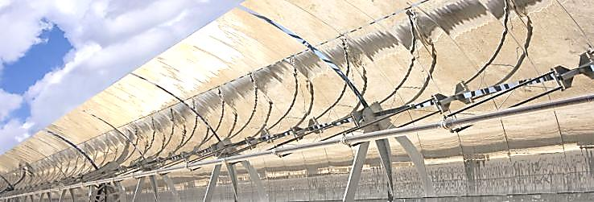
Example of R&I targets
Solar Thermal Electricity (CSP/STE) 'Declaration of Intent'
1. Short-term: > 40% cost reduction by 2020 (from 2013) translating into
Supply price* < 10 c€/kWh for a radiation of 2050 kWh/m²/year (conditions in Southern Europe)
2. Longer-term: develop the next generation of CSP/STE technology
New cycles (including supercritical ones) with a first demonstrator by 2020, with the aim to achieve additional cost reductions and opening new business opportunities.
* The supply price is meant to be the targeted price within
Power Purchase Agreements (PPA) with a duration of 25
years

Slide 11

The SET Plan Actors
ETIP
European Technology & Innovation Platforms
Industrial Pillar
Continuation of existing ETPs and EIIs in unified Platforms per technology.
Recognised interlocutors about sector specific R&I needs
Composition – covering the whole innovation chain: industrial stakeholders (incl. SMEs), research organisations and academic stakeholders, representatives of businesses, regulators, civil society and NGOs, representatives of MS
Provide strategic recommendations to and input for the SET Plan Steering Group on the 10 priorities
Role in the implementation
NEW
NEW
NEW

