Slide 1
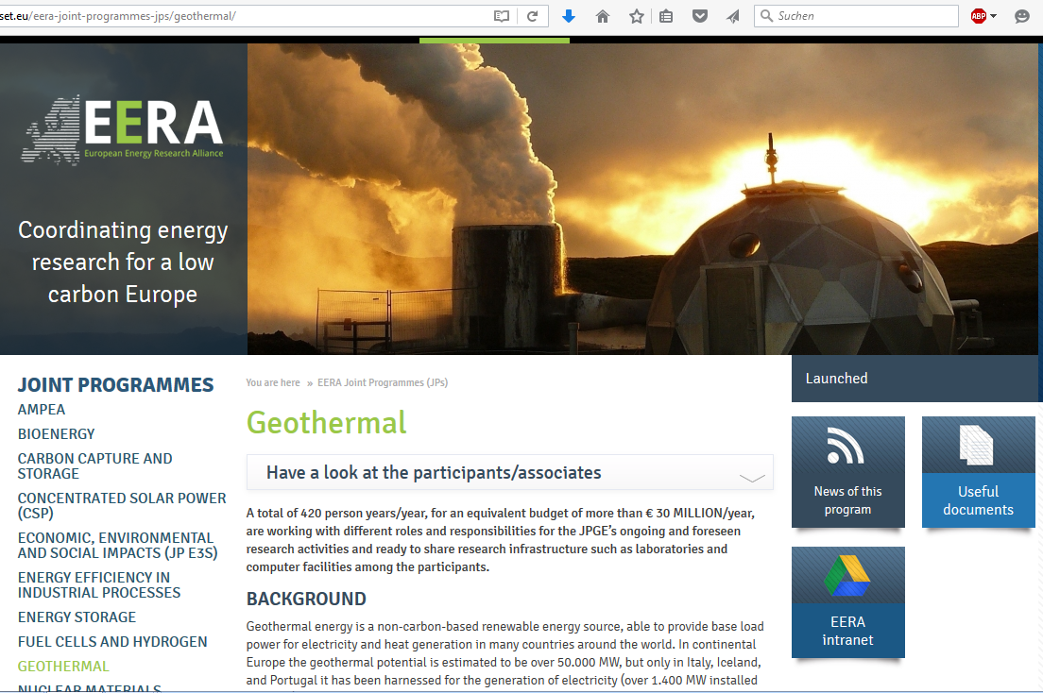

Slide 2
EERA – JPGE Participants
2010
2012
2013
Short Name | Country
BRGM | France
CEGL | Italy
CNR | Italy
CNRS | France
CRES | Greece
ETH Zürich | Switzerland
GFZ Potsdam | Germany
ISES | Netherlands
ISOR | Iceland
KIT | Germany
LIAG | Germany
TNO | Netherlands
Short Name | Country
Uni Neuchâtel | Switzerland
ENEA | Italy
INGV | Italy
LNEG | Portugal
PT Milano | Italy
BGS | UK
RWTH Aachen | Germany
U Torino | Italy
VITO | Belgium
IFE | Norway
U Bari | Italy
U Trieste | Italy
TU Darmstadt | Germany
Short Name | Country
TÜBITAK | Turkey
OGS | Italy
PT Torino | Italy
IRIS | Norway
GZ Bochum | Germany
Sintef | Norway
2014
CMR- Norway
Uni Roma Tre – Italy
ORC-AXIS - Germany
Current status:
35+ participants
13 countries
~400 persons
12 participants
7 countries
~250 persons
25 participants
11 countries
~350 persons
UFZ- Germany
Polish Geological Institute - Poland

Slide 3
Large scale research infrastructure
Deep geothermal energy, both hydro- and petrothermal:
Soultz-sous‐Forêts BRGM, KIT (F), → EGS
Triest OGS (I), Testfield geophysical methods
VisLab UFZ (D), Process visualisation
Gross Schönebeck GFZ (D), → Deep thermal water loop
Stavanger IRIS (N), → Drilling simulator
GeoLaB KIT (D); (2022 +), → EGS
IDDP ISOR (Is), → supercritical Reservoir
…
Äspö SKB (S),
Grimsel NAGRA (CH),

Slide 4
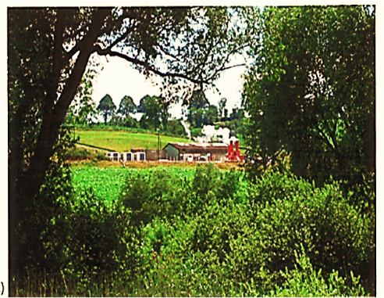
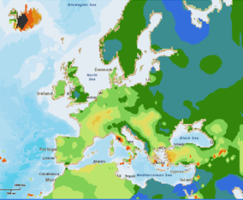
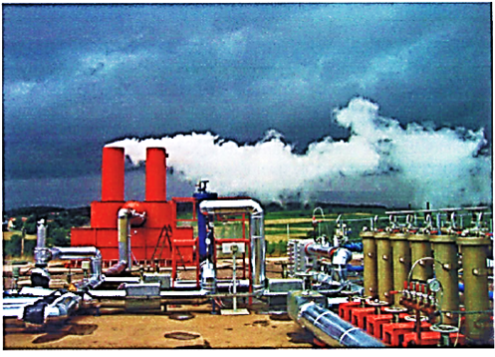
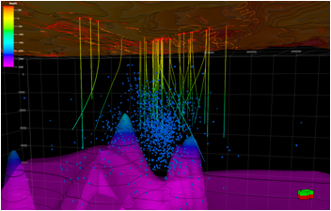
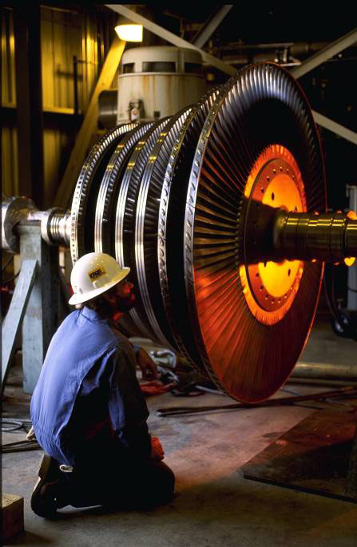
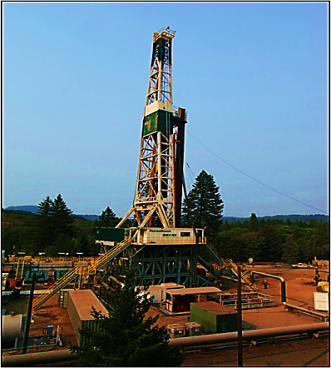
Structure of the JPGE
SP1
Resource Assessment
SP2
exploration
SP 3
Accessing and engineering a reservoir
SP4
PROCESS ENGINEERING and management of geothermal systems
SP5
Sustainability, enviroment and regulatory framework
_{Overall goal}
_{Development of new}
cost– effective technologies suitable for a sustainable growth of geothermal energy in Europe and worldwide

Slide 5
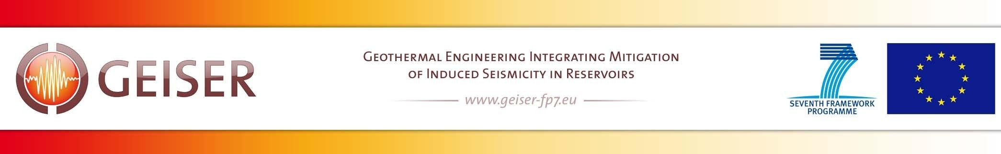
Geothermal Engineering Integrating Mitigation of
Induced SEismicity in Reservoirs
The European GEISER project
2010-2013
Develop mitigation strategies of induced
seismicity in geothermal systems
•
•
Provide legal and administrative guidelines
licensing of geothermal power generation
Funding period: 42 months, starting January 2010
Co-funded by the European Commission within FP7
13 partners from 7 countries, 2 industry
→ SP 3, 4, 5
for

Slide 6
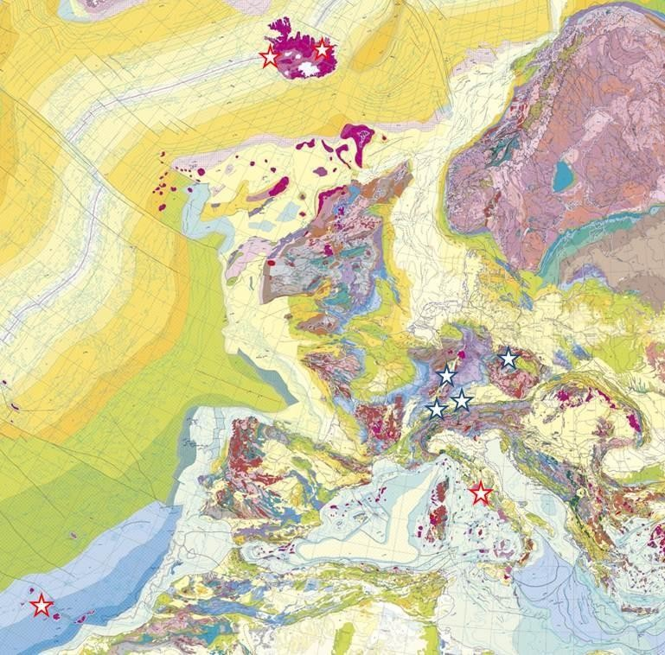

IMAGE:
Integrated Methods for Advanced
Geothermal
Exploration
Magmatic sites
Non-magmatic sites
November 2013 + 4 years
Budget: 13 Mio €, (incl. EC 10 M€)
19 partners (6 from industry)
→ SP 1, 2

