Slide 1


Cooperation between European countries through the Geothermal ERA NET
European Technology and Innovation Platform (ETIP) on Deep Geothermal constitutional Meeting
Brussels, Belgium
6 April 2016
slides from
Guðni A Jóhannesson Director General, Orkustofnun, Iceland
Geothermal ERA NET Coordination Office
presented by Paul Ramsak Netherlands Enterprise Agency / RVO Leader WP2 Information Exchange
The Geothermal ERA NET is supported by the European Union's Seventh Programme, for research, technological development and demonstration under grant agreement No 291866

Slide 2




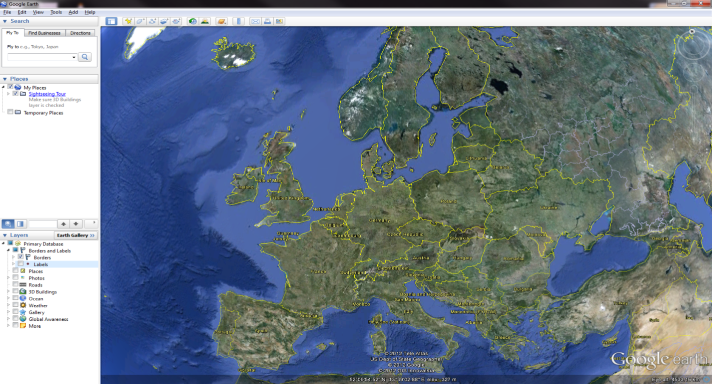

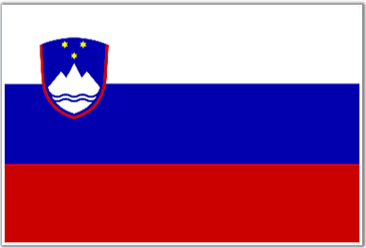

Geothermal ERA-NET Consortium
IS Orkustofnun (National Energy Authority, Iceland)
NL Rijksdienst voor Ondernemend Nederland
CH Swiss Federal Office of Energy (SFOE)
I National Research Council of Italy (CNR)
D Jülich (PTJ)
F ADEME ( BRGM as third party)
IS Icelandic Centre for Research (RANNÍS)
TR TÜBITAK (Scientific and Technological Research Council of Turkey)
SVK Slovak Ministry of Education, Science, Research and Sport
MFIG Hungarian Geological and Geophysical Institute
SED Slovenian Energy Directorate
EAD Electicidade dos Acores
Lead partner is Orkustofnun
operating the Geothermal ERA NET
Coordination Office
Good geographical balance (North-West to South-East Europe) Partner countries chosen a.o. on basis of their 2020/2050 geothermal ambitions
New partners

Slide 3



Objective
Communicate with principal stakeholders and enhance public awareness on the added value and benefits of geothermal scientific and policy issues
Increase transnational collaboration in research training and mobility
Prepare Policy and Implementation for a
Common European Geothermal Action Plan
for geothermal energy technology research, development, deployment and innovation supported by member states
Prepare and Implement Joint Geothermal Activities
(e.g. transnational funding activities)

Slide 4


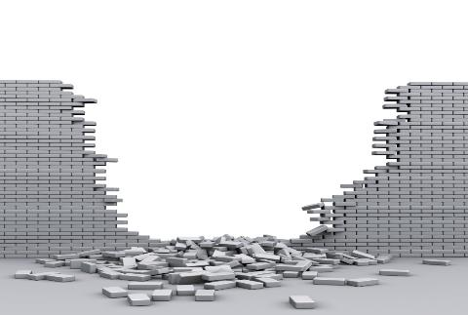

Objective
Exchange information on the status of geothermal energy
Lay groundwork to create a
European Geothermal Information Platform
Highlight barriers and recommend practical solutions
Recommend measures
to
Strengthen European
Geothermal Development,
for
Economic Opportunities,
Energy Security
and Mitigate Climate Change

Slide 5

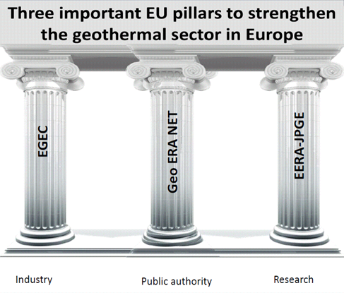
EU pillars of the geothermal sector
“third pillar” – public sector

Slide 6
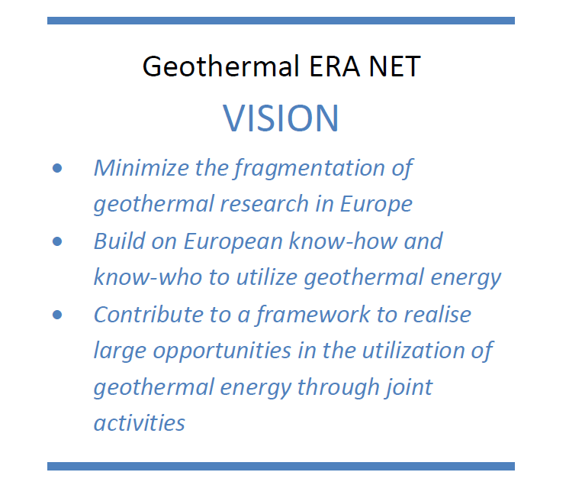
Vision

Slide 7

Objective and Task – Preparing Next Steps
Analysis -> Assessments -> Joint Activities –> Implementation –> Future Policy
WP1 – ICELAND Coordination, Management & Dissemination
WP3 – ITALY
Towards a EU Geothermal Database
WP7- ITALY
Implementation of joint activities
Evaluation, Assessment,
Coordination
Policy
Formulation
and
Proposal
ERA NET +
or other
SET PLAN input
WP2 – NETHERLANDS Information exchange on national incentives and status of geothermal energy
WP4 – GERMANY Development of joint activities
WP6 – ICELAND Transnational Mobility & Training
WP5 – SWITZERLAND Engaging with stakeholders

Slide 8
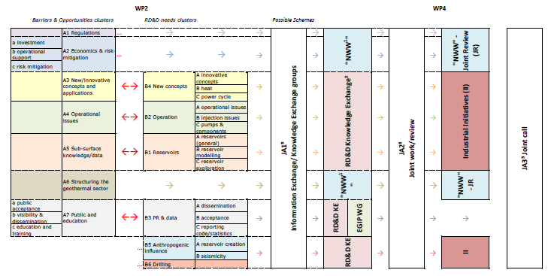
Joint activities

Slide 9
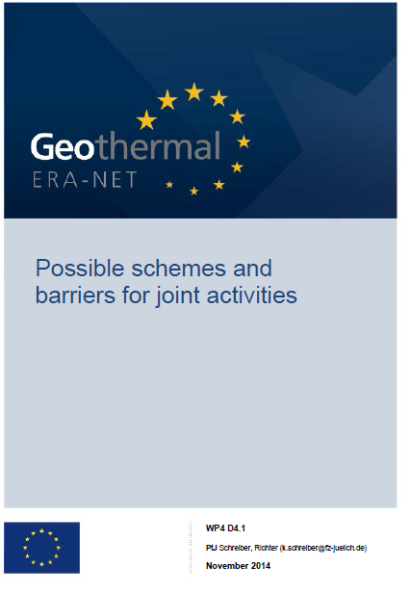
Joint activities
Operation and steering of research funding
Financial instruments for the enabling of private investment
Operational issues
Public relations
New concepts
Reservoir sustainability
Interoparibility of data
EGIP
Types of actions:
Identify and engage affected stakeholders, lead experts of the specific topics
Organization of workshops, roundtables
Publictaions of workshop proceedings, recommendations

Slide 10
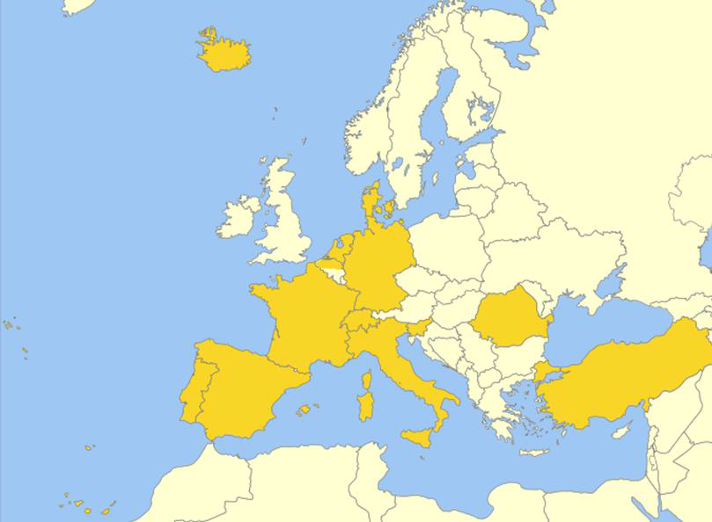
Follow-up: GEOTHREMICA ERA-NET Co-fund action
ERA-NET Cofund Action GEOTHERMICA (2017-2021) submitted on 5 April 2016 (LCE-34-2016)
16 «Research Program Owners and Managers» from 13 european countries
Targeted funds for 1st Call: € 25-30 million (33% EU contribution, 67% input from partners)
«Transnational Call» for Pilot- and Demonstration Projects with very strong industry participation
Target «Direct use & power generation embedded in an energy system» - more specified during the Call
Decision of the European Commission expected for Q4-2016
1st Call (to be launced and evaluated by GEOTHERMICA): Q2-2017 (two-stage process: 1) project concept, 2) full proposals; award of contracts mid-2018)

Slide 11

www.geothermaleranet.eu
Project leader: Gudni A Jóhannesson (gudni.a.johannesson@os.is)
Project manager: Hjalti Páll Ingólfsson (hjalti.p.ingolfsson@orkugardur.is)
Leader Information Exchange: Paul Ramsak (paul.ramsak@rvo.nl)
Prof.dr. Gudni A Jóhannesson

