Slide 1
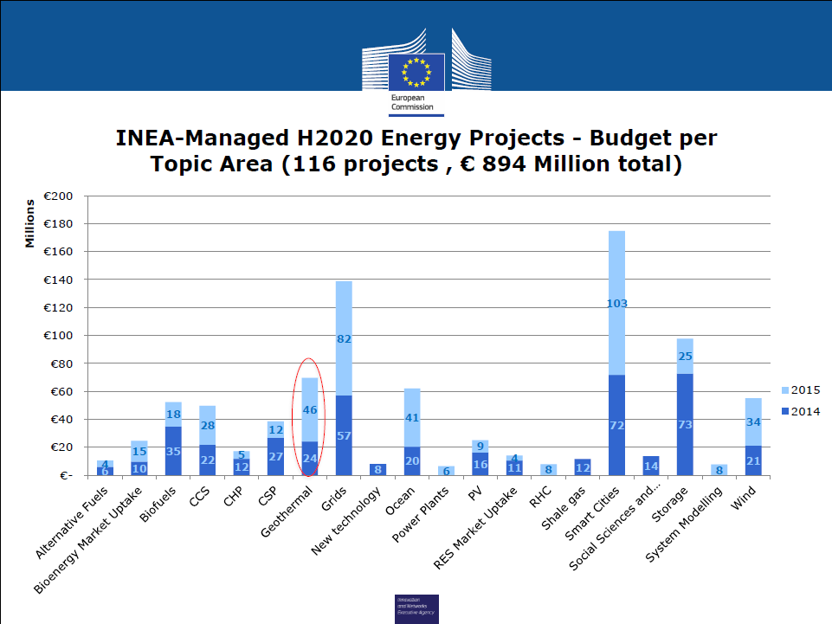

Slide 2
Ongoing EU-projects
Project | EC Contr. (M€) | Total Cost (M€) | Funding
DESCRAMBLE | 6.8 | 15.6 | H2020
Thermodrill | 5.4 | 5.8 | H2020
CHPM2030 | 4.2 | 4.2 | H2020
GeoWell | 4.7 | 4.7 | H2020
SURE | 5.9 | 6.1 | H2020
DeepEGS | 20 | 44 | H2020
DESTRESS | 11 | 25 | H2020
GEOTeCH | 7.1 | 9 | H2020
Cheap-GSHPs | 4.8 | 5.8 | H2020
IMAGE | 10.1 | 13.3 | FP7
Geothermal ERA NET | 2.0 | 2.4 | FP7
InnoDrill |  | 3 | Norway
SUM | 82.2 | 138.7
Drilling, Stimulation, Completion, Monitoring
most of them presented in Utrecht 8.3.16,
a Joint Geothermal Project Meeting organized by Thomas Reinsch
OPPORTUNITY TO SHAPE THE EUROPEAN GEOTHERMAL FUTURE

Slide 3
New Projects on Geothermal Energy started (Horizon2020)
SURE: Novel Productivity Enhancement Concept for a Sustainable Utilization of a Geothermal Resource
coordinated by GFZ ; start: 1 March 2016, 42 months, 10 partners
Focus: Investigation and testing of the Radial Water Jet Drilling technology for increasing the performance of geothermal wells with low productivity across different spatial and temporal scales.
GEOWELL: Innovative materials and designs for long-life high-temperature geothermal wells
coordinated by Iceland GeoSurvey (ÍSOR); start: 1 February 2016, 36 months, 8 partners
Focus: Development of reliable and cost effective technologies for design, completion and monitoring of high-temperature geothermal wells to accelerate the development of geothermal resources.
DESTRESS: Demonstration of soft stimulation treatments of geothermal reservoirs
coordinated by GFZ ; start: 1 March 2016, 48 months, 16 partners
Focus: Development of site specific concepts to enhance the productivity of low permeable geothermal reservoirs to actively make reservoir conditions profitable.
→ SP 3
→ SP 3, 4
→ SP 3, 5

Slide 4

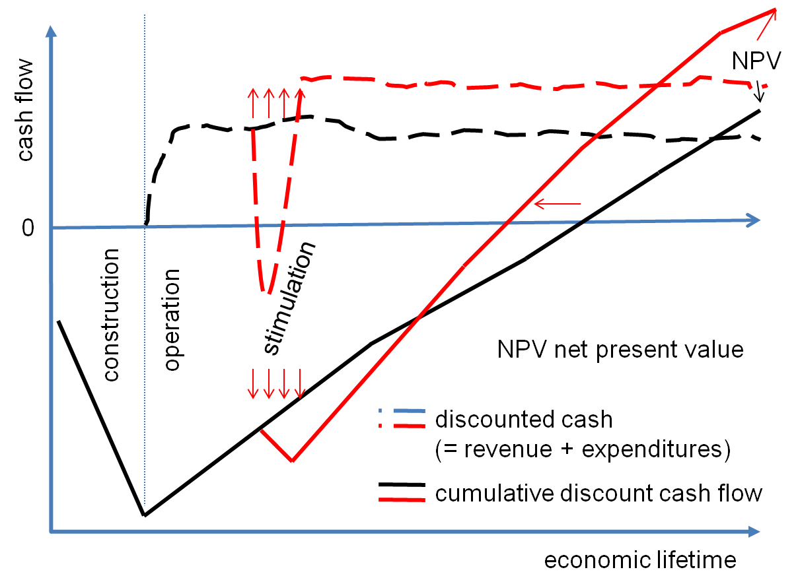
Cash flow and net present value of an EGS project
Business case of technical solution from DESTRESS
Stimulation leads to more thermal flow from the formation and higher cash flow; → invest in stimulation treatment for economically viable projects
Industrialization of geothermal energy
needs a systematic and safe technique to
create efficient EGS
Issues of public acceptance and all market and regulatory barriers including financing and other supply-side issues of relevance influence the business
→ DESTRESS addresses
Relevant key factors and impacts
Advances in the Technology Readiness Level
Risk reduction
Regional approaches
Socio-economic and environmental aspects
Notes:
The economic aspect (NPV) should be better linked to the main objective: the stimulation of the formation or in easier words: everything is about to increase flow trough the formation to get more energy out of the formation, and therefore better economics, all of course without important risks and with public acceptance. Therefore I propose to make clear the following causalities:
Soft and successful stimulation => => more energy out of the underground => much better economics.
Evaluation of performance and cost targets
Identification of potential issues of public acceptance and all market and regulatory barriers including financing and other supply-side issues of relevance
Regional approaches and other socio-economic and environmental aspects from a life-cycle perspective (e.g. pollution and recycling)
Standardisation needs, synergies between technologies (including those for storage)

Slide 5
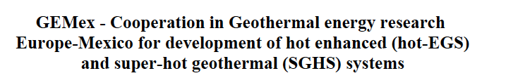
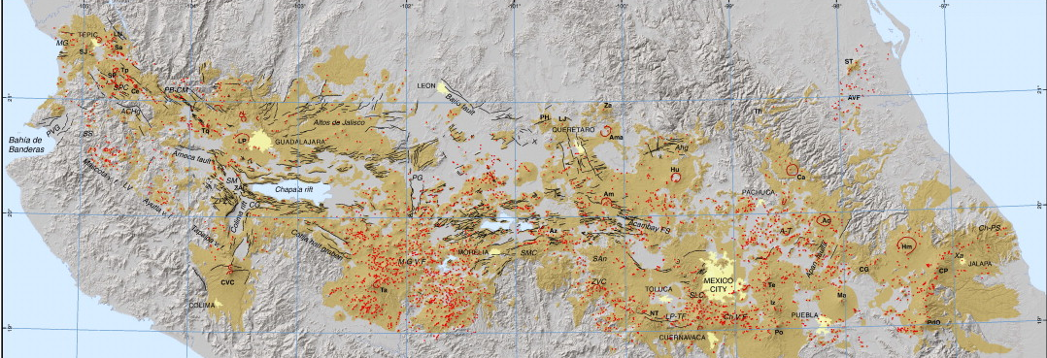
EU-MEXICO JOINT PROPOSAL
ACOCULCO
LOS HUMEROS

Slide 6

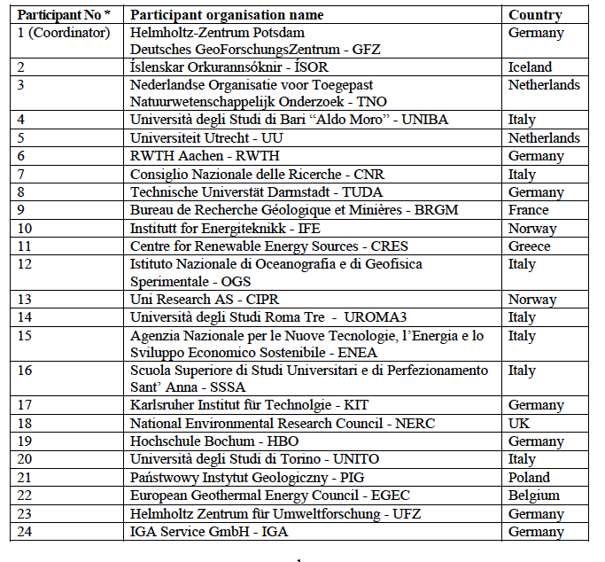
GEMex
EU_MEXICO JOINT PROPOSAL
10€ FUNDS from EC
9 universities
11 Research institutions
2 Geological Surveys
EGEC
IGA

Slide 7
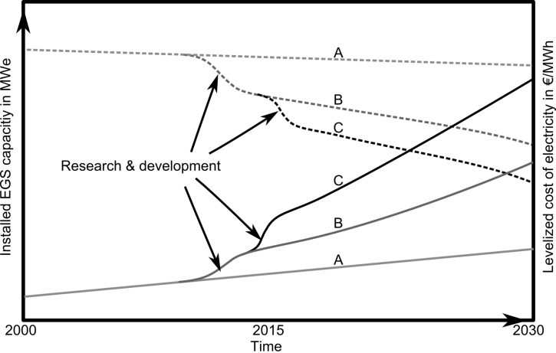
Conclusions
Research is well funded in H2020 → progress in technology can be expected
Knowledge and technology transfer needs to be organised
EERA JPGE Expectation from ETIP
Clearly defined stakeholder groups in ETIP
as contacts for and partners in projects resp. EERA JPGE
for accelerating the deployment of geothermal energy in Europe
A: business as usual
B: Improvements in Exploration
C: Imrovement in Reservoir Engineering

