Slide 1
EUROPEAN TECHNOLOGY & INNOVATION PLATFORM (ETIP) on
DEEP GEOTHERMAL organised by
EGEC
UNCOVENTIONAL GEOTHERMAL TECHNOLOGY (EGS)
by
Roy Baria* and Joerg Baumgaertner**
(*MIL-TECH UK Ltd & EGS Energy Ltd; **BESTEC (GmbH)
© EGS Energy Ltd

Slide 2
WORLD CLIMATE CHANGE IS A WORLDWIDE PROBEM
A MEETING WAS HELD AT THE WORLD BANK IN WASHINGTON DC
ON 5th March 2015 under IGA/UNECE*/World Bank
One of the item which was highlighted was
the disparity
between
conventional geothermal resource
and
high density of population in the world.
ie SUPPLY & DEMAND
for geothermal energy
*= United Nations Economic Commission for Europe
© EGS Energy Ltd

Slide 3
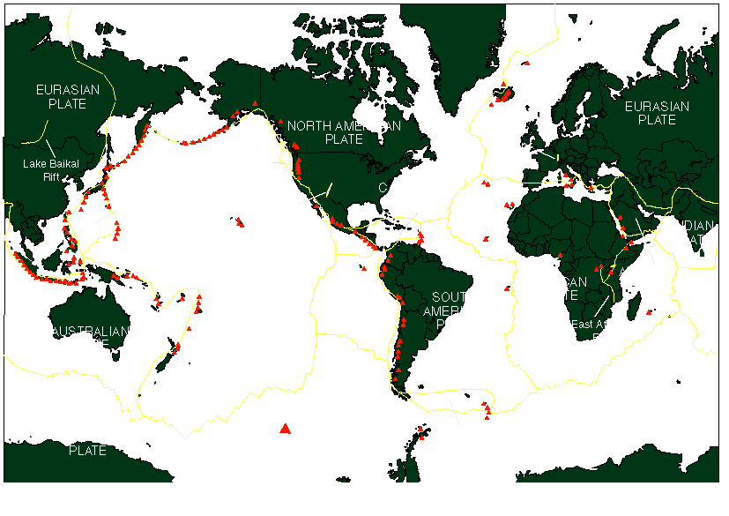
Plate Boundaries & conventional Geothermal resource (SUPPLY))
“Ring of Fire”
Geothermal
power plants
© EGS Energy Ltd

Slide 4
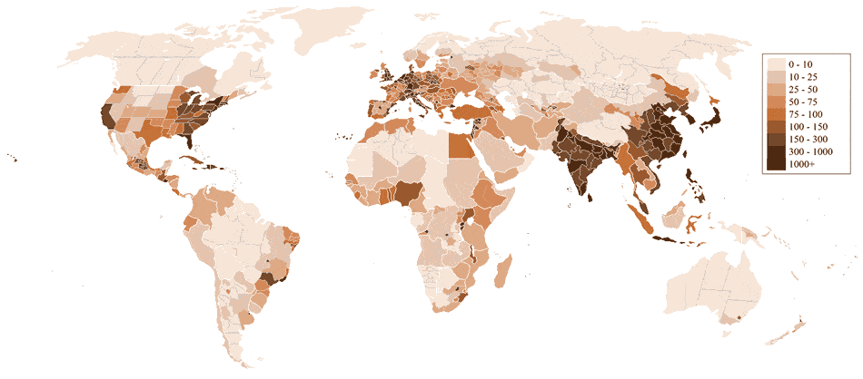
World Population Density (people/km²)
(DEMAND)
World population is ~7 billion (estimated by the UN)
geothermal is devoid of the population density
© EGS Energy Ltd

Slide 5
If Geothermal Energy is going to play
an important part in
industrialised & populated area
then
new & unconventional type of
geothermal resources (EGS)
needs to be identified and exploited
where the population density is high and
not on the margins of continents.
© EGS Energy Ltd

Slide 6
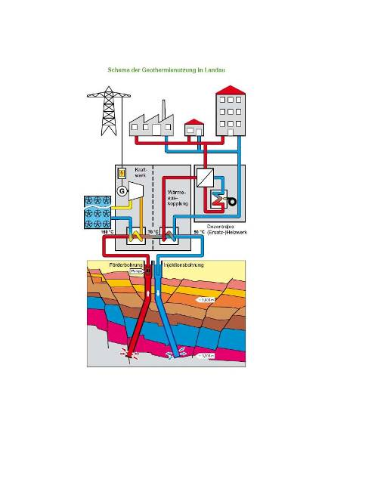
Commercial EGS project in Insheim, Germany
COMMERCIAL PROJECTS AT
Landau & Insheim
Temp ~165°C
Flow 60-80 l/s
Power output ~ 4MWe
Supply space heating network
near populated area (very important)
Injection
well
Production well
Maximum
Horizontal stress
Fault 2
Fault 1
New Concept of accessing deep
permeable faults in igneous basement
© EGS Energy Ltd

Slide 7
Satellite image of faults
If they have similar characteristics, like in Insheim &
Landau, then they are capable of delivering ~ 70 l/s
indefinitely. Theses can be like having a hydrothermal system in igneous rock.

Slide 8

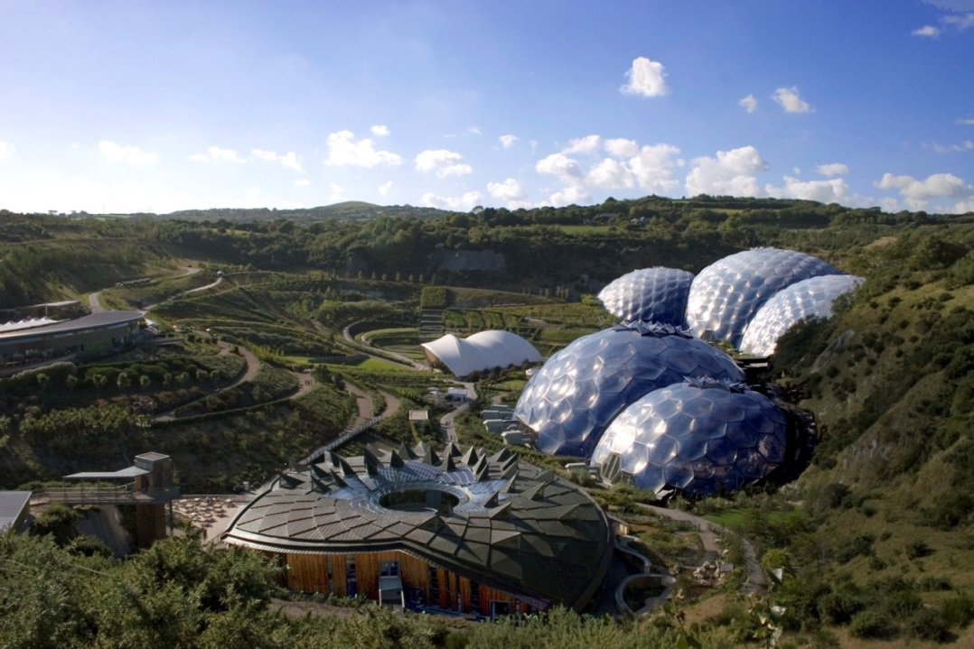
A CHINA CLAY PIT IN ST. AUSTELL
BEFORE
AFTER
Test the EGS concept at the
Eden Project, Cornwall
© EGS Energy Ltd

Slide 9
WHY?
The use of deep conductive faults is a European idea and came from the European
Research project at Soultz, France & the concept works in Rhine Graben.
Theses faults can be like having a hydrothermal system in igneous rock and
therefore more widely available than hydrothermal systems.
3. Will establish a European Leadership for EGS market in the world.
Create a European Centre of Excellence which will include a number of Universities from Europe to unify the European research on this topic
Almost a million visitors go to the Eden project each year and this will make the general public aware of the benefit of geothermal energy.
It will show that former mining areas can be converted to re-usable environmentally friendly sites.
7. Further technology will be developed to improve the economics.
8. It will demonstrate to other European nations that geothermal energy can be
assessable using this technology, both heat and power.
9. European Commission will be able to help the climate change issue by supporting
development of such projects in populated areas of the world.
International cooperation will be encouraged. IEA/GIA and EGEC will be apart of
the supervisory group who will advice on the future direction of this technology.
© EGS Energy Ltd

Slide 10
Thank you
© EGS Energy Ltd

