Slide 1

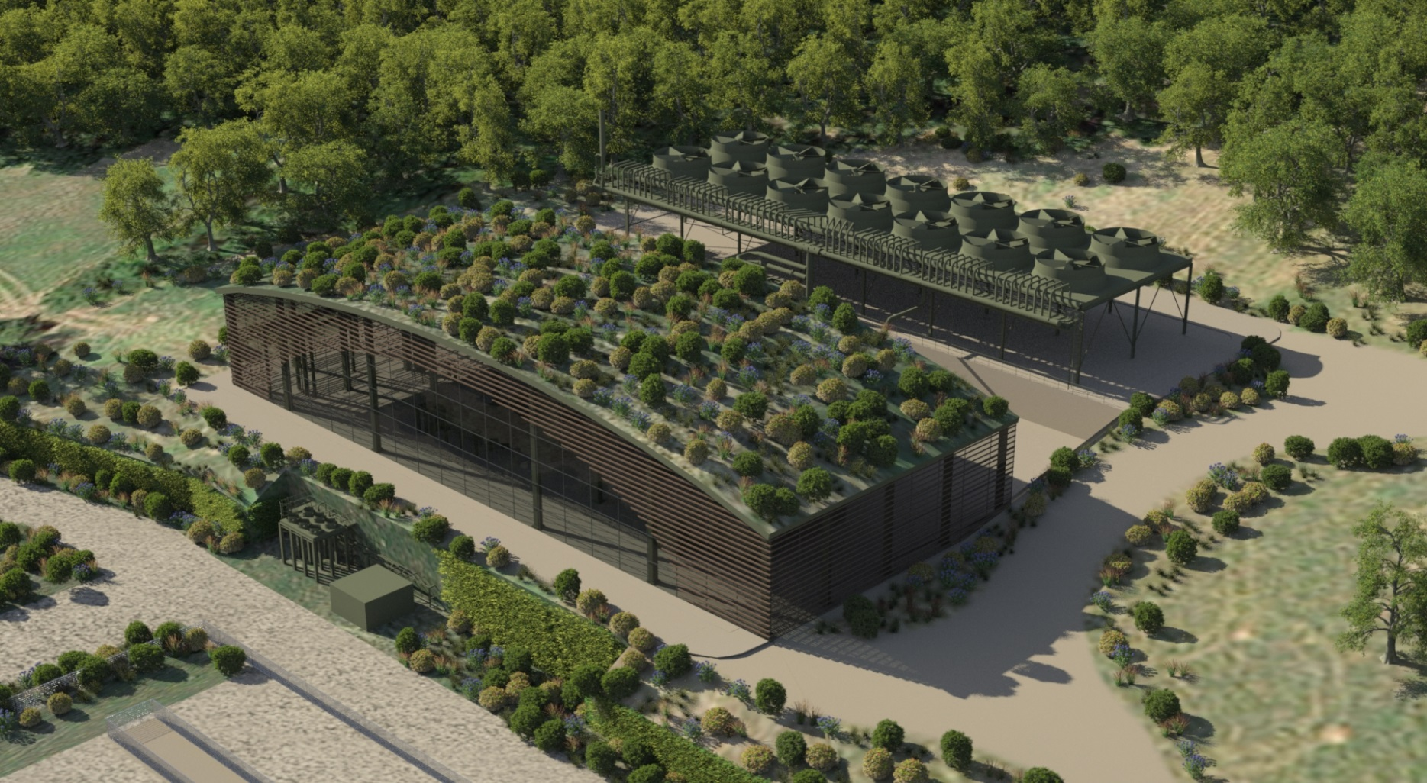
Constitution meeting
European Technology and Innovation Platform (ETIP)
on Deep Geothermal
GEOTHERMAL ENERGY 2.0
An industry and environment priority
BRUXELLES , 6 APRIL 6 2016

Slide 2
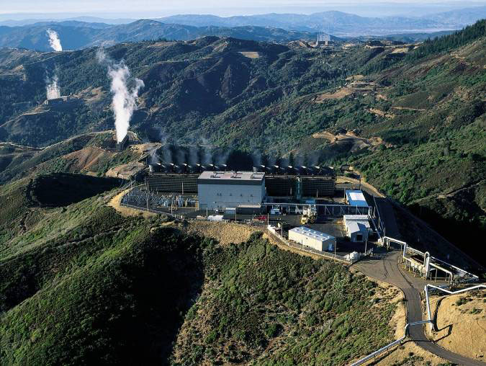
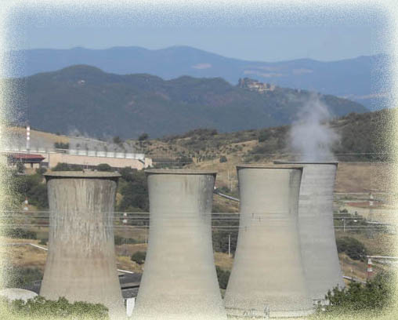
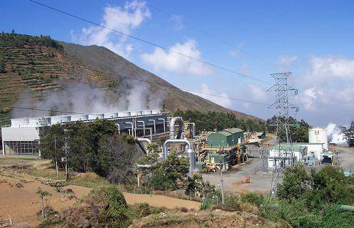
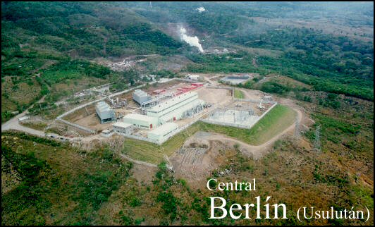
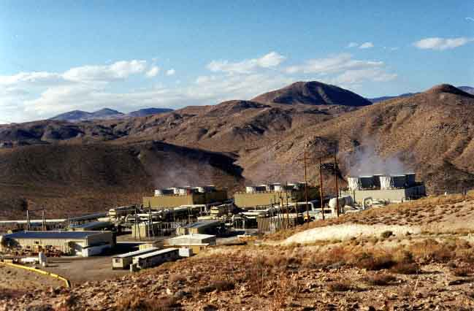
«CONVENTIONAL» GEOTHERMAL POWER PLANTS
ENVIRONMENTAL IMPACT
  AERIFORM EMISSIONS
  (from WELLS and POWER PLANTS)
  EFFLUENTS
    WATER VAPOR (50 -70 % OF TOTAL FLUID PRODUCTION)
    DROPLETS CONTAINING POLLUTANTS (B, As,Hg, …)
    GREENHOUSE GASES (CO₂, CH₄, )
    UNPLESANT SMELL (H₂S)
    OTHER VOLATILE POLLUTANTS (NH₃, H₂, N₂, Rn,…)

Slide 3
GEOTHERMAL ENERGY 2.0- «CLOSE LOOP» POWER PLANTS
To improve the environmental sustainability
Total re-entry of the geothermal fluid produced in the geological formations of origin, with no steam and gas emissions into the atmosphere;
Environmental integration and landscape (“site-specific”)
Enhancement of thermal application processes compatible with local vocations
ZERO EMISSIONS” AND TOTAL REINJECTION
ARE MANDATORY FOR THE SOCIAL ACCEPTANCE AND ENVIRONMENTAL SUSTAINABILITY OF GEOTHERMAL PROJECTS

Slide 4
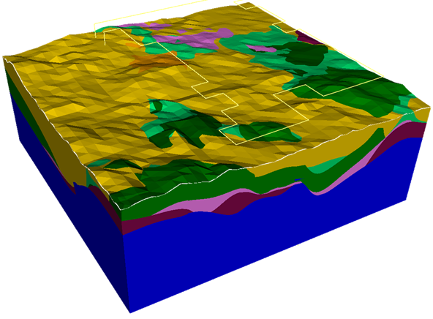
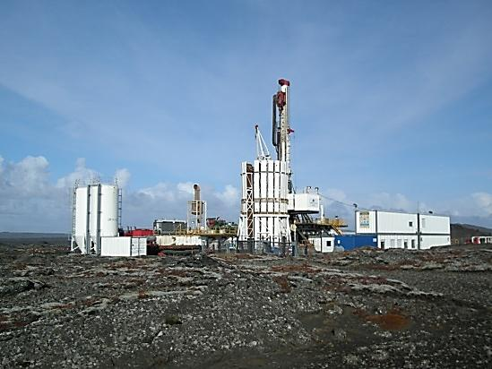

TECHNOLOGICAL CHALLANGES
RESOURCE ASSESSEMENT
&
MANAGEMENT
3D IMAGING OF SUBSURFACE
RESERVOIR MODELLING
RESERVOIR MONITORING
DRILLING
NEW COST EFFECTIVE TECHNOLOGY
HT WELL LOGGING TOOLS
ENVIRONMENTAL SUSTAINABILITY
POWER SYSTEM
IMPROVEMENT OF EFFICIENCY
SMALLER FOOT PRINT
BETTER LANDSCAPE INTEGRATION

Slide 5
GEOTHERMAL ENERGY 2.0 - RETE GEOTERMICA
A cluster of enterprises has been established in Italy
with the main common goal to develop new technologies
for “closed loop” geothermal projects
RETE GEOTERMICA is willing to be
a stakeholder of ETIP on Deep Geothermal, and
to cooperate for the development of its Strategic Research Agenda

Slide 6
THANKS FOR ATTENTION

Slide 7
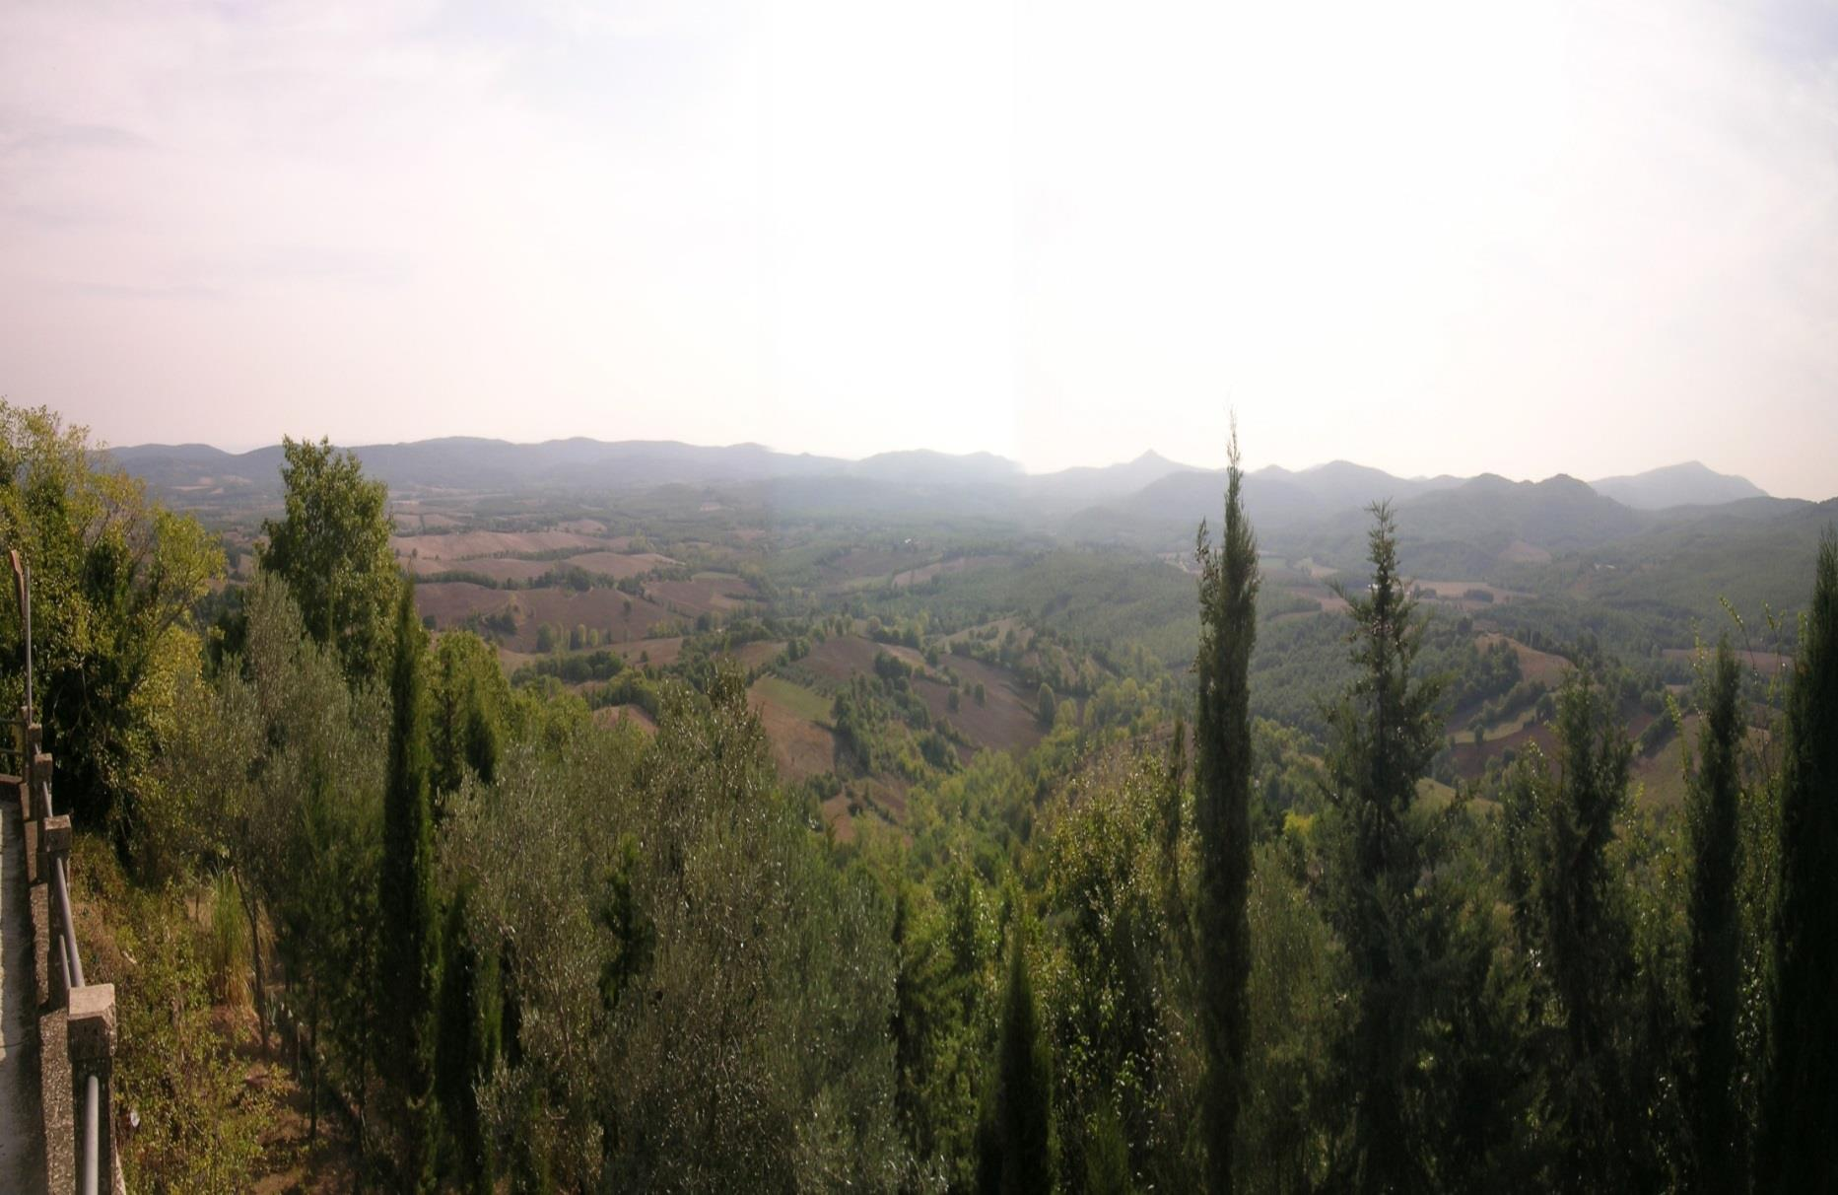


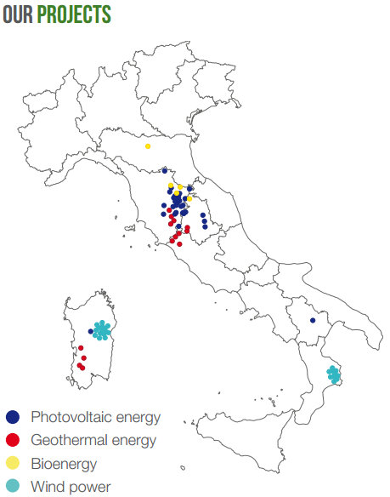
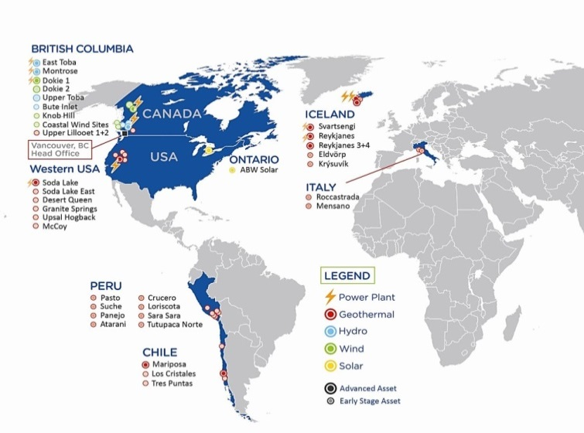
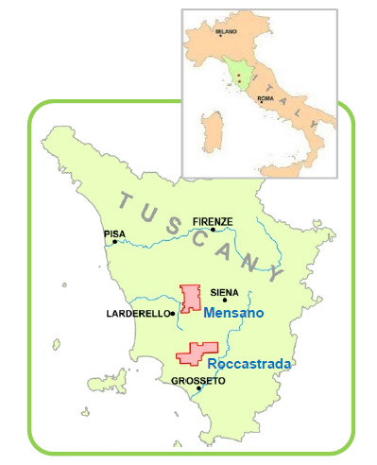
MAGMA ENERGY ITALIA
55%
45%
Mensano
Exploration lease
( 215 km²)
Roccastrada
Exploration lease
( 272 km²)
MW

Slide 8
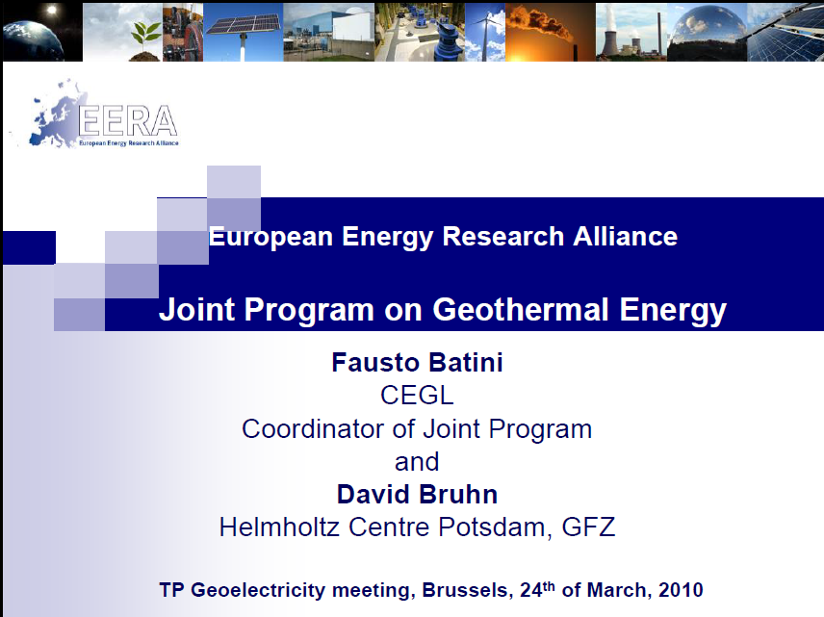
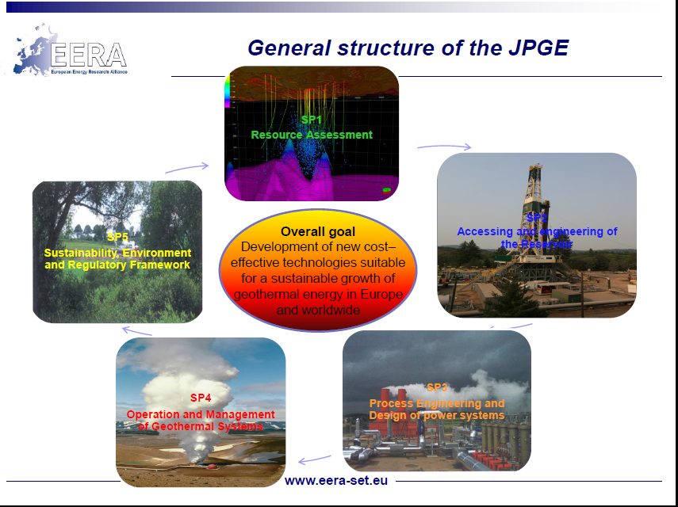

GEOTHERMAL ENERGY 2.0 – TECNLOGICAL CHALLANGES

Slide 9
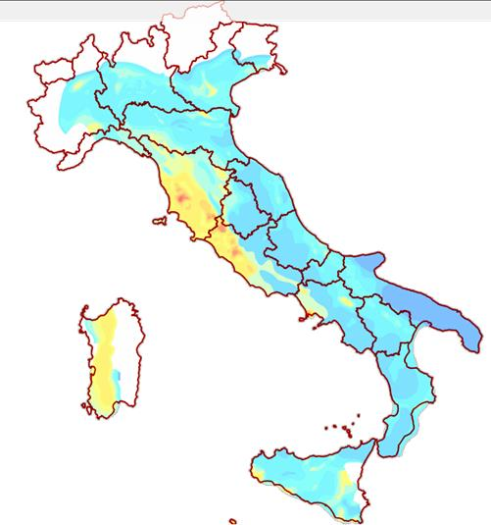
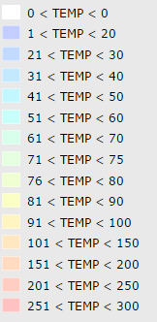
GEOTHERMAL ENERGY 2.0 - DEVELOPMENT SCENARIOS IN ITALY
Geothermal potential (@ 2040)
Power capacity: 3000 – 3500 MW
Electric generation : 24–28 TWh/year
About 8-10% of energy needs in Italy
(today about 1,6 % )
15 Bilion Euro investiment
100.000 new jobs
  50.000 jobs during construction
  20.000 jobs during power plant operation
  30.000 jobs for direct uses of heat in industry, agriculture, etc.
Source RETE GEOTERMICA
Temperature @ 2000m b.s.l.
Source Geothopica (http://geothopica.igg.cnr.it/)

