Slide 1



European Technology Deep Geothermal & Innovation Platform
Turboden experience in geothermal application
Marco Baresi – Institutional Relations
Brussels, 6th April 2016

Slide 2
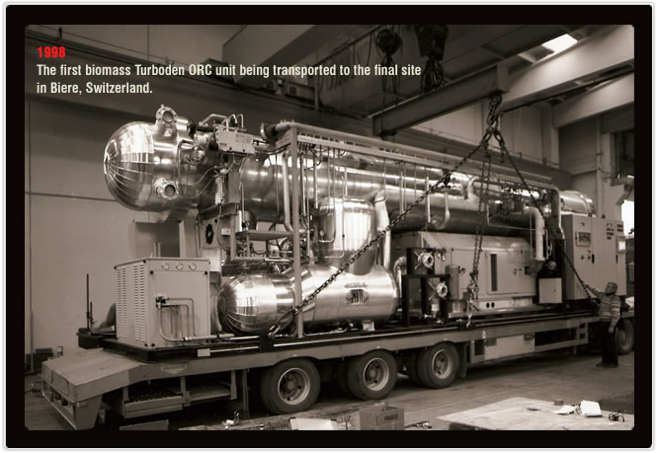
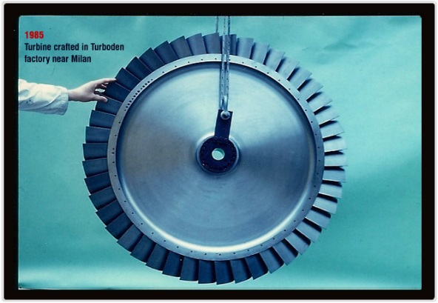

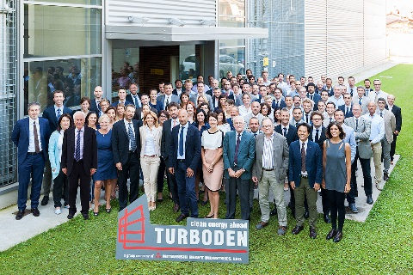
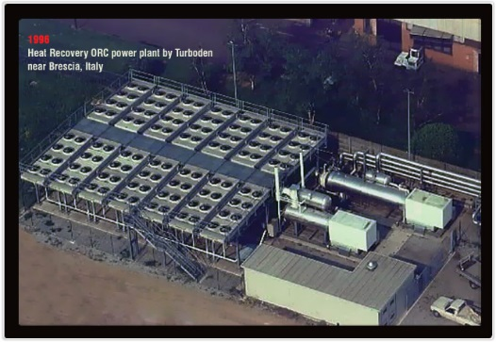
35 Years of Experience
2013 - MHI acquires the majority of Turboden. Italian shareholders stay in charge of management
Today - Over 320 plants in the world, 265 in operation,
200+ employees,
∼ 70 M€ turnover
(2015)
1998 – First ORC biomass plant in Switzerland
(300 kW)
1980 - Founded by Mario Gaia, professor at Politecnico di Milano
2000‘s - ORC biomass plants in Europe
1990’s – First ORC projects in solar, geothermal and heat recovery applications
2009 - United Technologies Corp. (UTC) acquires the majority of Turboden’s quotas. PW Power Systems supports Turboden in new markets beyond Europe. 100 plants sold

Slide 3

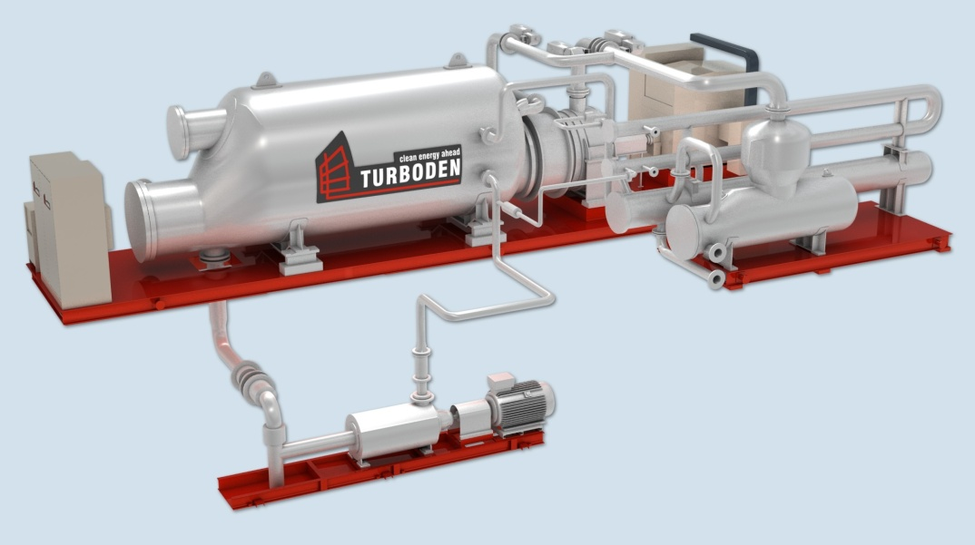
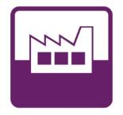



What We Do
Biomass
Heat recovery
electricity
Waste to energy
heat
Turboden designs, develops and maintains turbogenerators based on the Organic Rankine Cycle (ORC), a technology for the combined generation of electric power and heat from various renewable sources, particularly suitable for distributed generation.
Geothermal
Turboden solutions from 200 kW to 15 MW electric per single unit
Solar

Slide 4
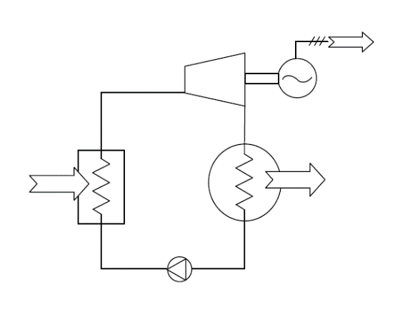
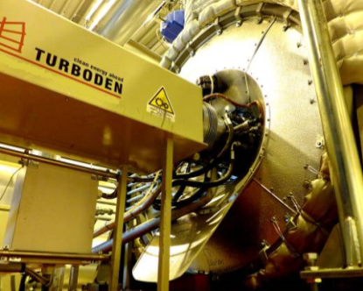
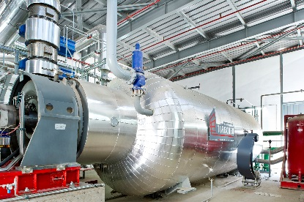
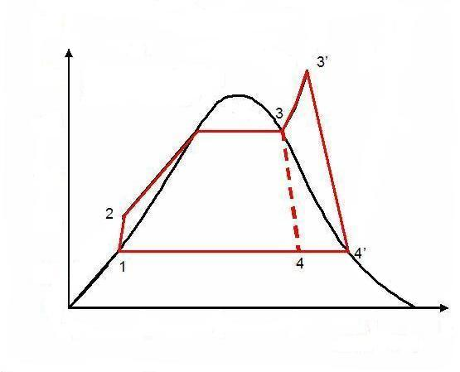
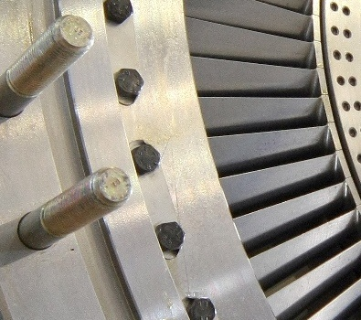
Organic Rankine Cycle: concept
Cycle it is a thermodynamic cycle
Rankine it is theoretically given by 2 isobar and 2 adiabatic thermodynamic transformations
Organic it exploits an organic working fluid
EXPANDER
EVAPORATOR
FEED PUMP
The principle is based on a turbogenerator working as a normal steam turbine to transform thermal energy into mechanical energy and finally into electric energy through an electric generator. Instead of the water steam, the ORC system vaporizes an organic fluid, characterized by a molecular mass higher than water, which leads to a slower rotation of the turbine and to lower pressure and erosion of the metallic parts and blades.
Efficiency: 98% of incoming thermal power is transformed into electric power (around 20%) and heat (78%), with extremely limited thermal leaks, only 2% due to thermal isolation, radiance and losses in the generator. The electric efficiency obtained in non-cogeneration cases is much higher (more than 24% of the thermal input).
Water / steam
Temperature
Entropy
Organic fluid
Temperature
Entropy

Slide 5
Geothermal technology: binary plant
BINARY PLANT
Generator
Evaporator
Binary
Turbine
Preheater
Feed Pump
Condenser
Production
Well
Injection Well
Brief explanation:
The geothermal source (mix of brine and steam or only brine) comes up from the production well. Then it is cooled through the heat exchangers giving heat to the binary fluid, which flows inside an independent loop. The cooled geothermal source is then entirely reinjected. The hot binary fluid passes through the turbine generating power, then it is condensed by means of a condenser (with water or air) and pumped again into the heat exchangers, so the cycle can restart.

Slide 6
Geothermal technology: flash plant
FLASH PLANT
Separator
Condenser
Production
Well
Cooling
Tower
Generator
Hotwell Pump
Steam
Turbine
Injection Well
Brief explanation:
The geothermal source (mix of brine and steam) comes up from the production well. Then liquid and steam are separated: the first one is reinjected, while the steam passes through the turbine to generate power. After the turbine, the exhaust steam is condensed by means of a semi-open circuit made by the condensate itself. The condensate is usually cooled in a cooling tower.

Slide 7
Geothermal technology: comparison between flash and binary plants
FLASH | BINARY
Mainly suitable for geothermal source when the steam share is significant and/or when the temperature is higher than 150 ÷ 200 °C | Mainly suitable for geothermal source where the liquid share dominates and the temperature is not so high (furthermore, binary plants are very favorable when the source temperature is lower than about 150 °C or when there is only liquid)
The plant uses the geothermal separated steam directly through the turbine, with related problems regarding the liquid formation and corrosion at the turbine blades | The plant has an independent closed fluid loop that exchanges heat with the geothermal fluids, so the geothermal fluid is in contact only with corrosion-resistant components
The cooling is usually made with water system, as the condensate becomes available as cooling medium | The cooling system can be made with either water or air or both of them
The cooled geothermal source is not entirely reinjected underground because part of it is lost in the cooling tower | The cooled geothermal source can be completely reinjected underground
Flash plants, together with dry steam plants, represent most of the installed capacity worldwide (around 85 %) | Binary plants represent approximately half of the number of total power plant all over the world

Slide 8
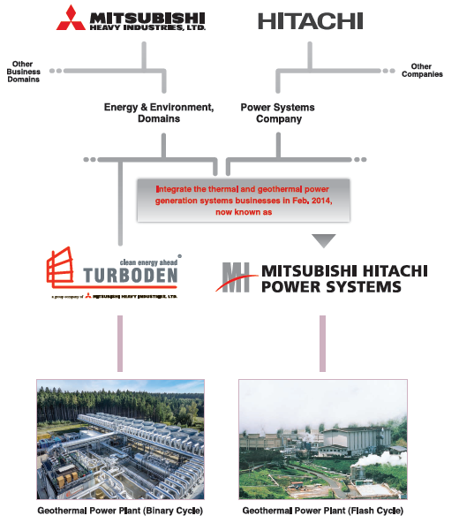
Global leadership in geothermal
over $40 billion (in fiscal 2014)
The largest segment of MHI
over $16 billion (in fiscal 2014)
> 320 ORC plants globally
0.5 GW ORC power
23 % market share
>100 units globally
> 3 GW power
Turboden is the worldwide reference ORC company for MHI

Slide 9
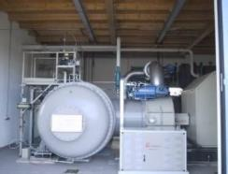
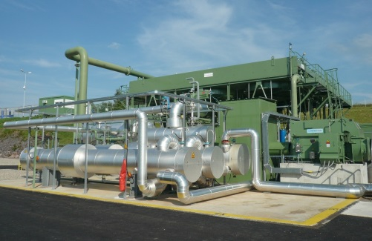

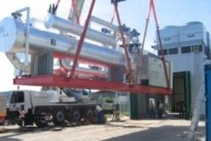

EU Turboden GEOTHERMAL Funded Demonstration Projects … since 2001
Marktgemeinde, Altheim, Austria
Soultz-sous-Forêts, Alsace, France
Simbach-Braunau,Germany/Austria
Plant type: geothermal low enthalpy, coupled with a geothermal district heating system
Started up: March 2001
Heat source: hot water at 106°C
Design electric power: 1 MW (normally operated by the owner at ~ 500 kW)
FP4-NNE-THERMIE C
Plant type: geothermal, 1st EU operating plant on EGS (Enhanced Geothermal System)
Started up: June 2008
Heat source: hot water at 180°C
Total electric power: 1.5 MW
FP6 - SUSTDEV
Plant type: geothermal low enthalpy, coupled with a geothermal district heating system
Started up: August 2009
Heat source: air/water at 80°C
Design electric power: 200 kW
FP6 - SUSTDEV

Slide 10
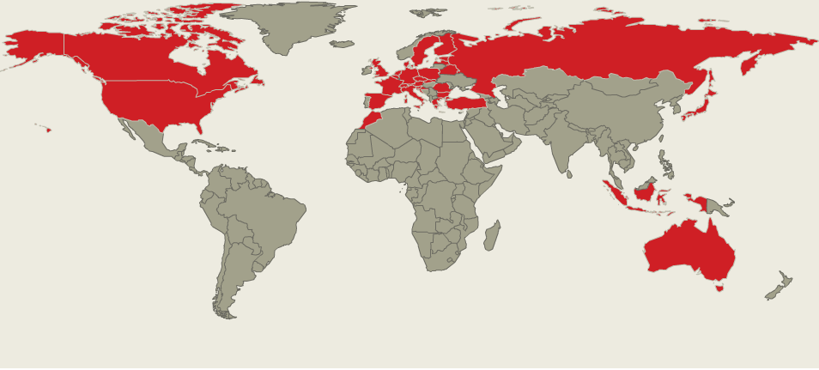
From pilots … to commercial projects
from pilots …
… to commercial projects

Slide 11
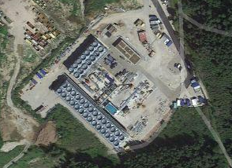
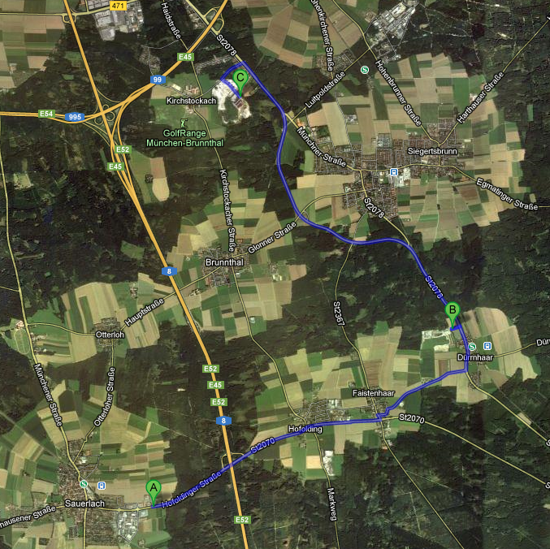
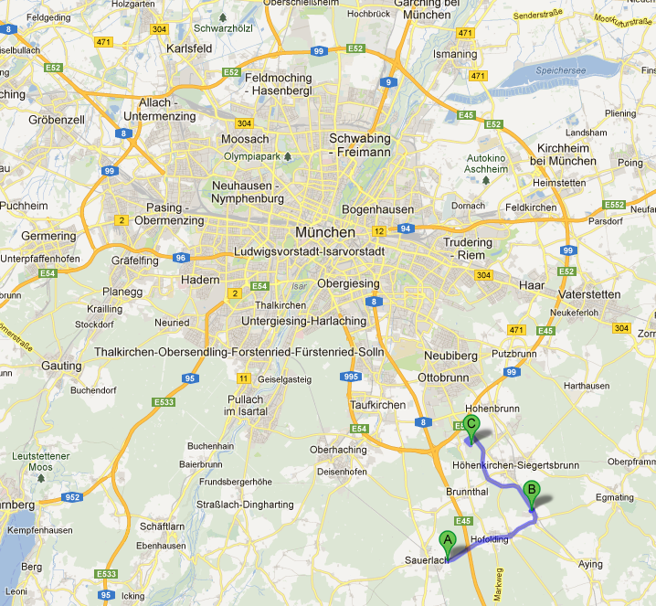
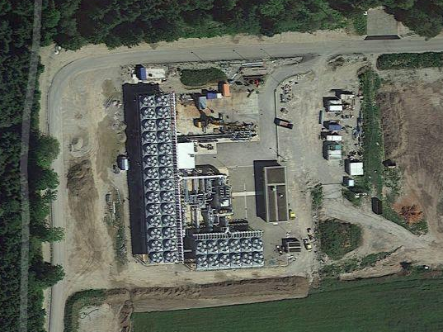
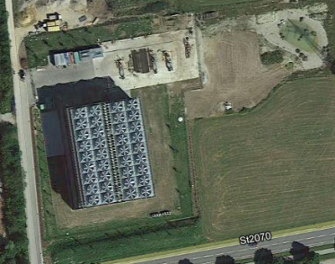
Turboden Geothermal Plants in operation in Bavaria since 2011 with 98% availability
Kirchstockach: 5,6 MWel
→ Traunreut:
4 MWel + 12 MWth
Dürrnhaar:
5,6 MWel
1 km
Sauerlach:
5 MWel + 4 MWth

Slide 12
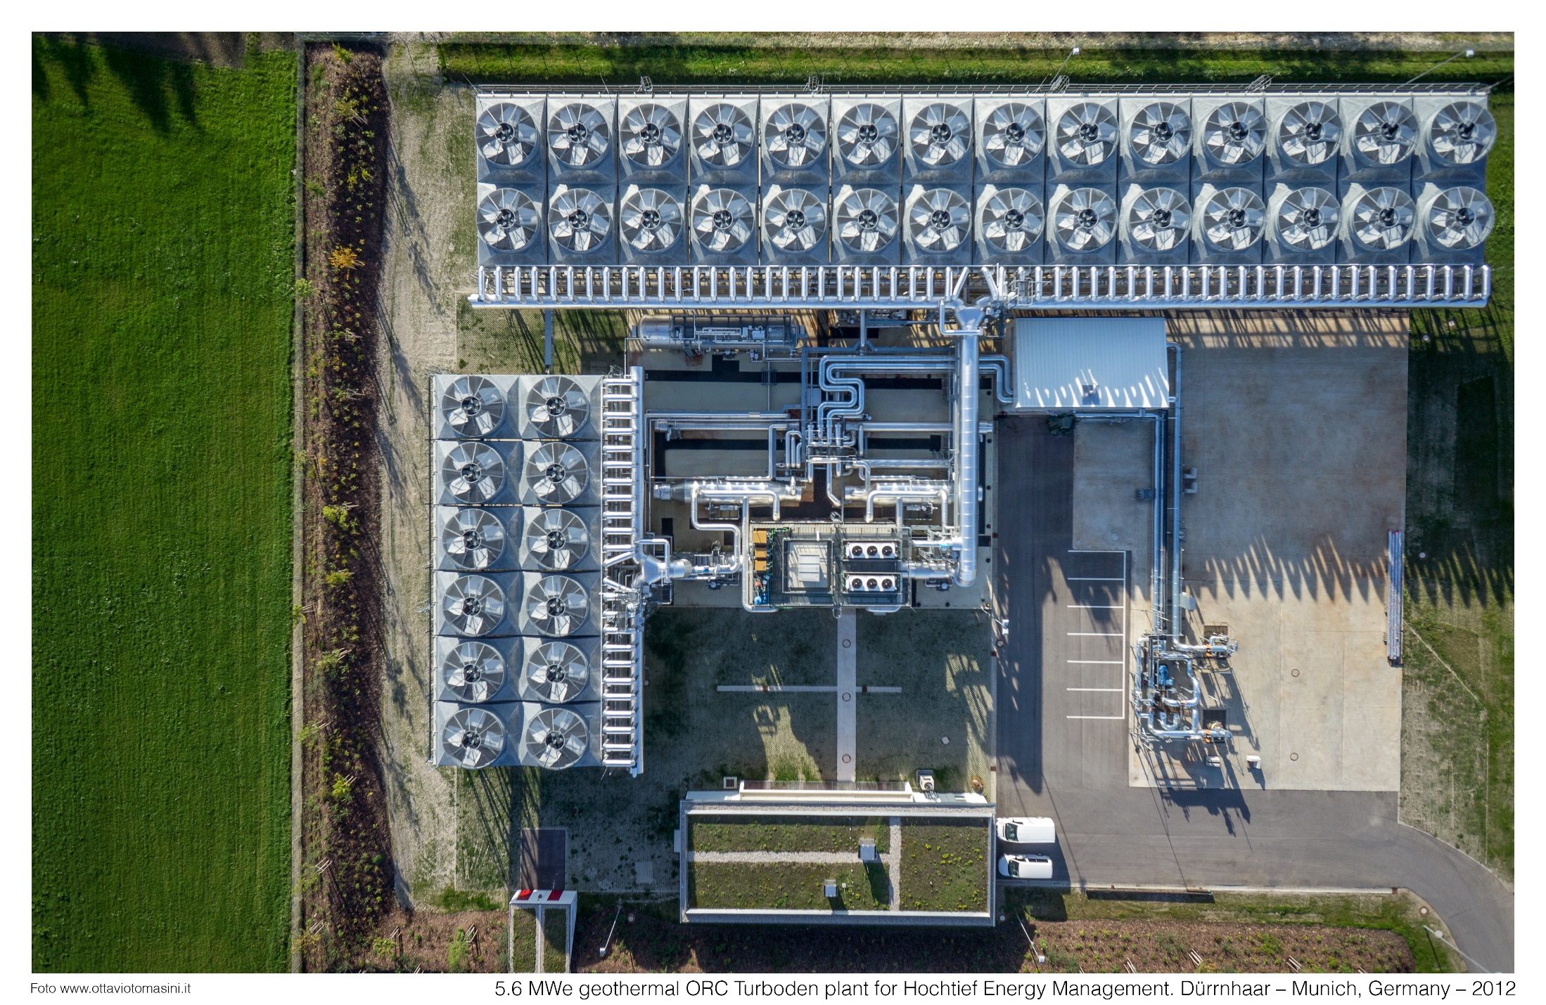
5 MWel typical Layout, a picture from Bavaria

Slide 13
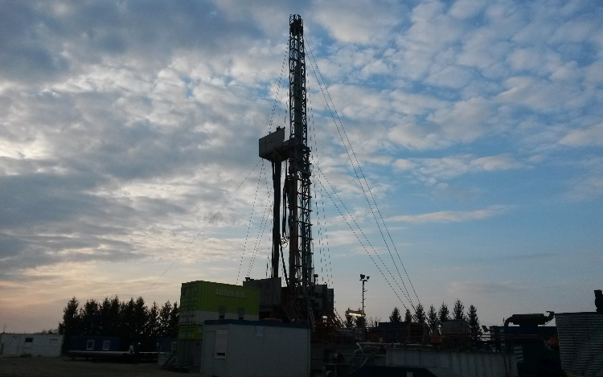
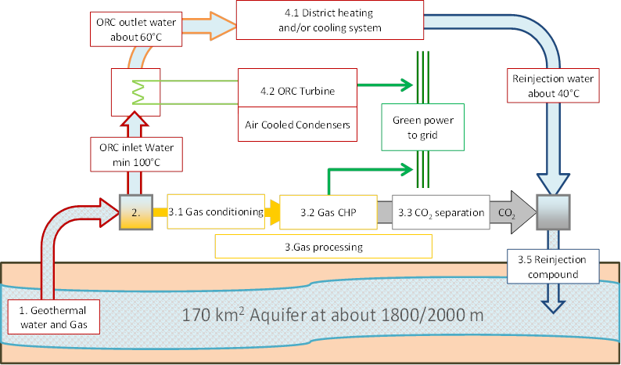
NER 300 project: CLEAG
Plant type: clozed loop technology
Customer: AAT Geothermae/CLEAG
Site: Croatia
Start up: Q2 2017
Heat source: geothermal brine @103°C
Cooling device: Air Cooled Condenser
Total power: 4.2 MW on a single turbine
Working fluid: Isobutane
CLEAG

Slide 14

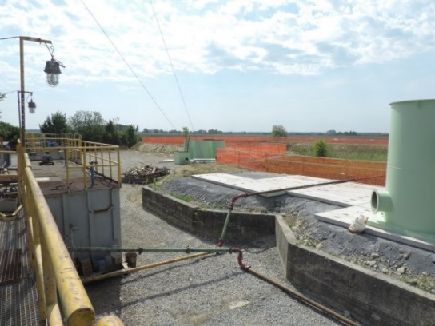
Plant under construction: 16.5 MW Velika Ciglena (Croatia)
Plant type: ORC geothermal unit
Customer: MB Holding
Site: Croatia
Start up: Q4 2016
Heat source: geothermal brine and steam @170°C
Cooling device: Air Cooled Condenser
Total power: 16.5 MW on a single turbine (including a 1.5 MW NCG expansion turbine)
Working fluid: Isobutane

Slide 15
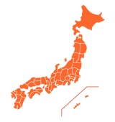
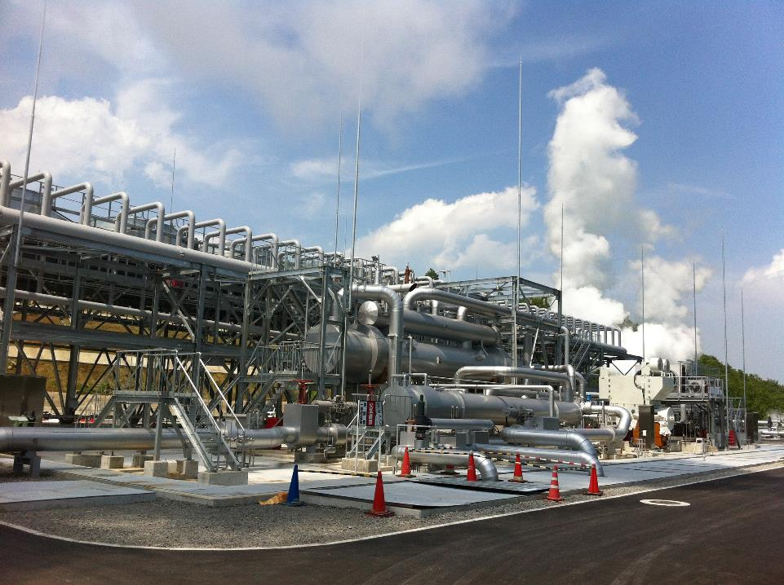
Recent project: Sugawara plant in Japan
Plant type: brine + steam ORC geothermal unit
Location: Japan
Status: in operation since June 2015
Heat source: geothermal brine/steam 140°C
Cooling device: air condensers
Total electric power: 5+ MW
Working fluid: n-pentane
Tokyo
Kyusyu/Oita

Slide 16


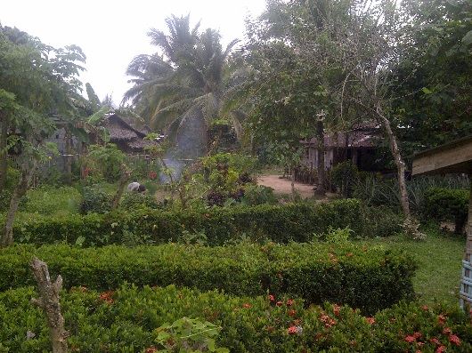
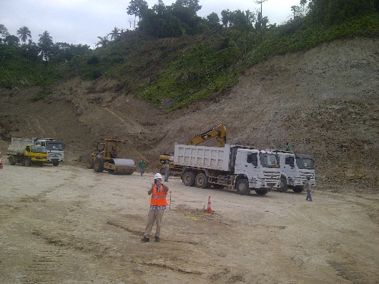
Plant under construction: Montelago geothermal (Philippines)
Plant type: 4 X Turboden 10 MW ORC units
Customer: Emerging Power Inc
Site: Mindoro Island, The Philippines
Start-up: under construction (first 10 MW foreseen for Q3/Q4 2017)
Heat source: geothermal fluid at 159°C
Cooling device: air condensers
Total power: 40 MWel net
Working fluid: Isopentane

Slide 17

Turboden’s vision of ETIP
Turboden is member of EGEC since 2007
Rete Geotermica
R&D was important and is still crucial for Turboden developments … with more than 320 ORC plants in 33 countries it represents an EU technology excellence
R&D further efforts are strongly recommended for ORC
focus on specific components
district heating application
increase cooling system efficiency
bottoming existing flash plants
testing the next generation of working fluids
storage and grid balance

Slide 18
Thank you for your attention
Marco Baresi – Institutional Relations Manager
marco.baresi@turboden.it

